Slide 1


AIML CA1 Part B
LIM JUN YI
DAAA/1B/FT/03

Slide 2
Aim of the assignment (Part B)
This is a regression problem
To build a machine learning model to predict the Cost($) based on many features in the data
Using the “CA1-Regression-Dataset.csv”

Slide 3
Entire Machine Learning Process
Preprocessing data
Train-test split
Training and tuning models
Evaluating the results
Duplicates
Impute
Outliers
Dummy variables
- Applying Train-test split on the dataset
- Standardisation (Scaling)
Two Methods:
Using all feature in the dataset
Using features Lasso CV chose to predict
- Training, comparing and testing the models with the 2 methods
- Find out which method is better for regression
- Tune the model and obtain the tuned results
- Find out which is the best model
- Create a dummy baseline to compare the best model
- Fit and predict with final model
- Evaluate the final score

Slide 4
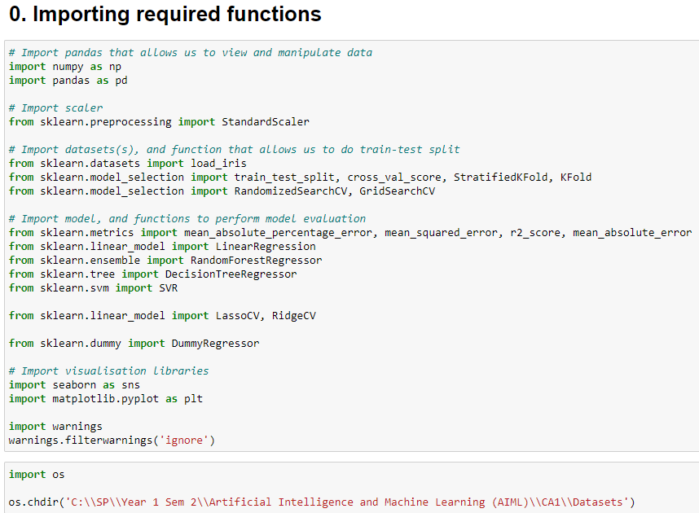
Importing Functions
Step 0: Importing Required Functions
Importing required functions
Changing directory to where the dataset is

Slide 5
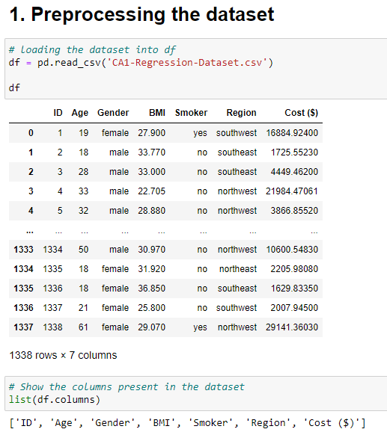
Loading data
Step 1: Preprocessing data
Loading and visualizing the data
Naming columns present in the data

Slide 6
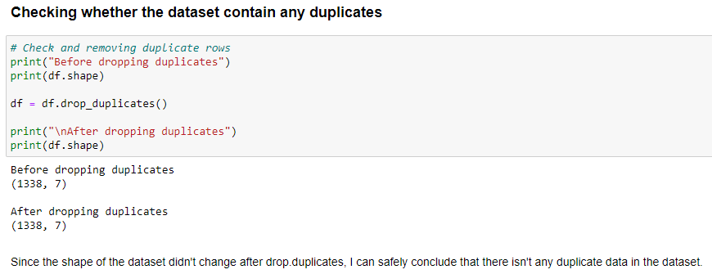
Removing Duplicates
1. Since the shape of the dataset didn’t change after drop_duplicates(), I can conclude that the dataset doesn’t contain any duplicates.

Slide 7
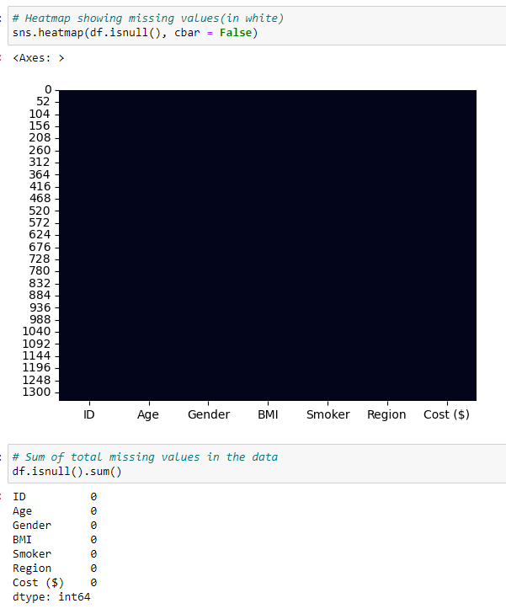
Check missing values
Plotting a heatmap to visualize whether the data contain missing values (white lines → missing values)
Showing total number of missing values in the data
Since there is no missing values in the data, there isn’t any imputation needed.

Slide 8
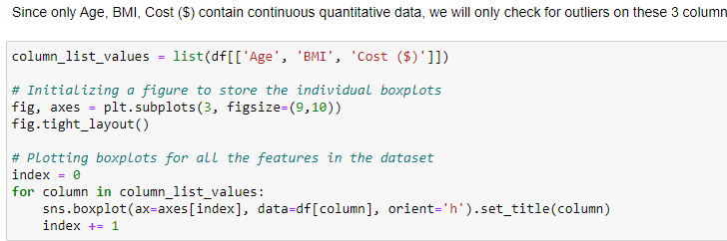
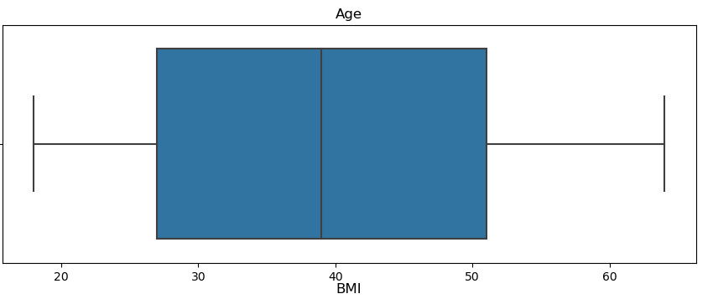
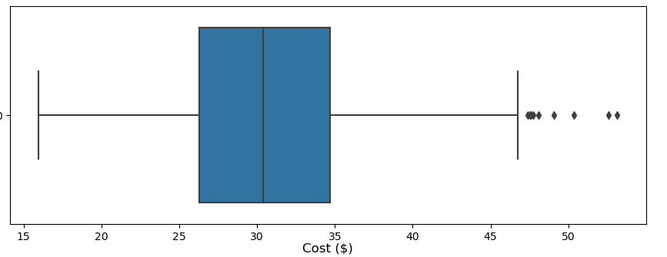
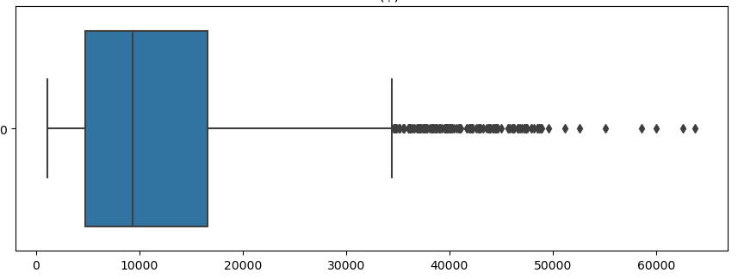
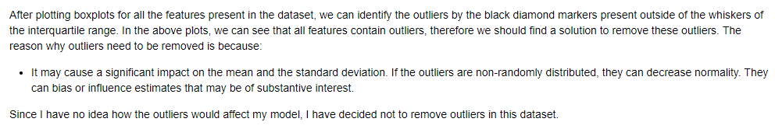
Check outliers
Plotting boxplots for each features to see whether they contain any outliers (black markers outside the First and Fourth Quarters are outliers)
Since only 1 column with continuous ‘BMI’ has outliers excluding the Cost($) (target), I decided not to remove any outliers as I feel that there will be little impact to the models’ performances.
Comments in the code:

Slide 9
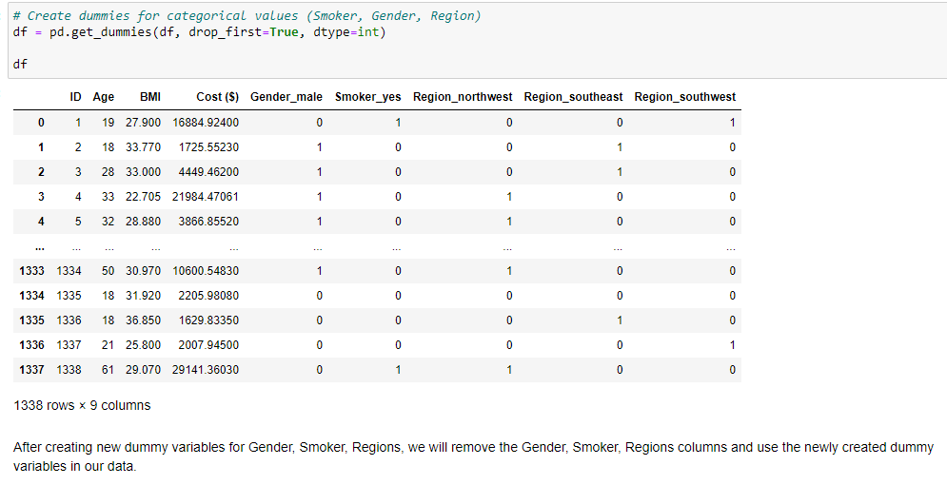
Creating Dummy variables
Since regression models don’t usually do well with categorial data, I have created dummy variables to replace the categorical data.

Slide 10
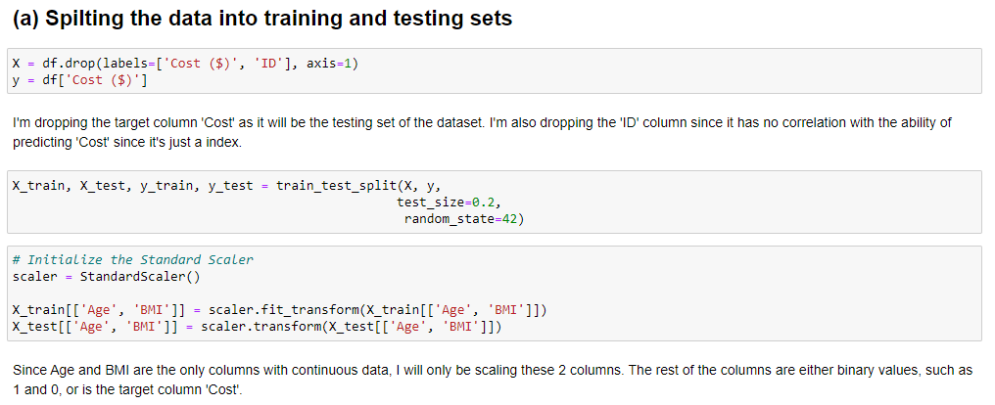
Train-test Spilt (Method 1)
Step 2: Train-test split
Dropping the unnecessary column & target from X
Applying Train-test split
Scaling only the ‘Age’ and ‘BMI’ columns as they are the only continuous data in the dataset, values of the rest of the features are binary showing true(1) and false(0).

Slide 11
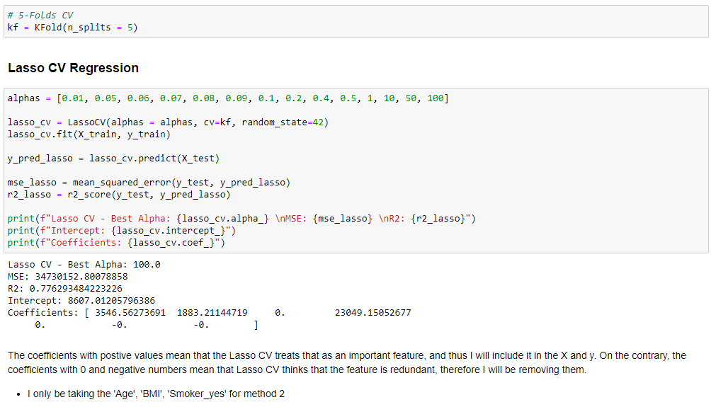
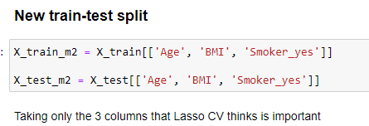
Train-test Split (Method 2)
Using Lasso CV to find out which are the unnecessary features and remove them out of the train-test split.
Activating Lasso CV to predict the previously created train-test split.
The features Lasso CV treats as useful features are only the ‘Age’, ‘BMI’ and ‘Smoker_yes’.
For the 2nd train-test split, it will only be the 3 features chosen by Lasso CV.

Slide 12
Process of training & tuning the models
Step 3: Training + Tuning of Models
I will be using 3 scores: Mean_Squared_Error (MSE), Mean_Absolute_Percentage_Error (MAPE) and R_squared to assess the models’ performances, by fitting the 2 different X_trains and evaluate the results.
Process of training + Tuning
1. Fitting the 2 different X_trains and looking at the 3 scores, finding which method (1 / 2) produces the better results.
2. Tune the model
3. Use Cross Validation to produce the models’ r_squared and use it to compare.

Slide 13
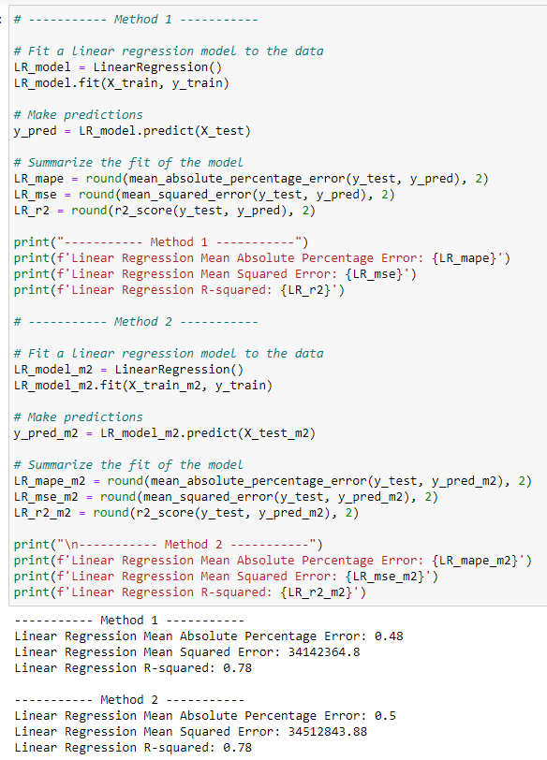
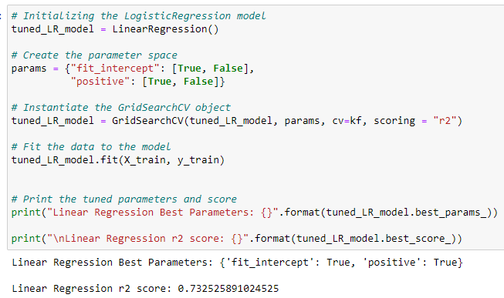
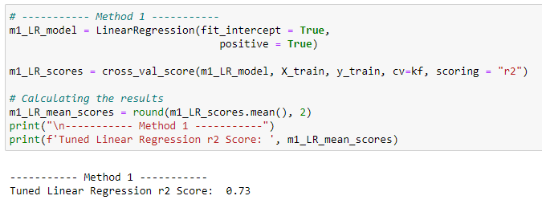
Linear Regression
1.
2.
Applying both methods, by fitting the 2 different X_trains into Linear Regression and output the 3 scores
Tune the hyperparameters of Linear Regression
Using Cross Validation to find the r_squared which will be used for comparison
Method 1 is better
3.

Slide 14
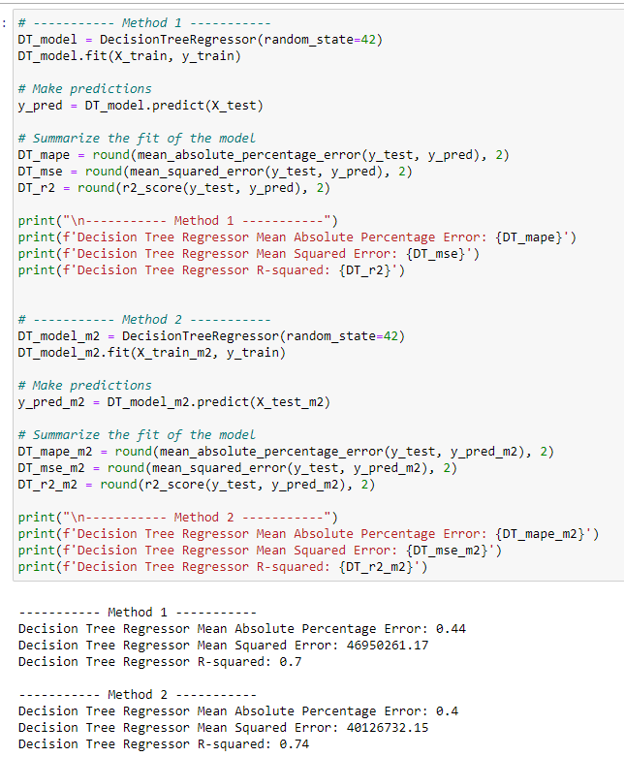
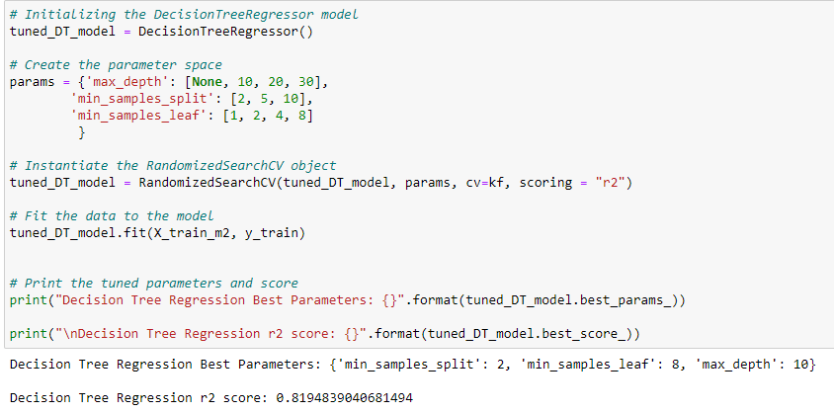
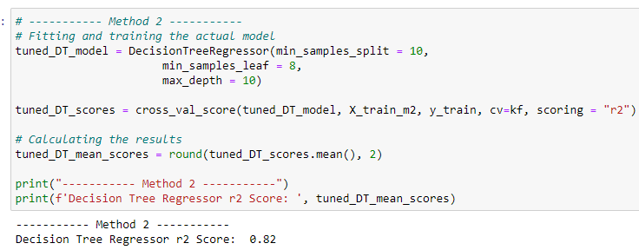
Decision Tree Regressor
1.
2.
Applying both methods, by fitting the 2 different X_trains into Decision Tree Regressor and output the 3 scores
Tune the hyperparameters of Decision Tree Regressor
Using Cross Validation to find the r_squared which will be used for comparison
Method 2 is better
3.

Slide 15
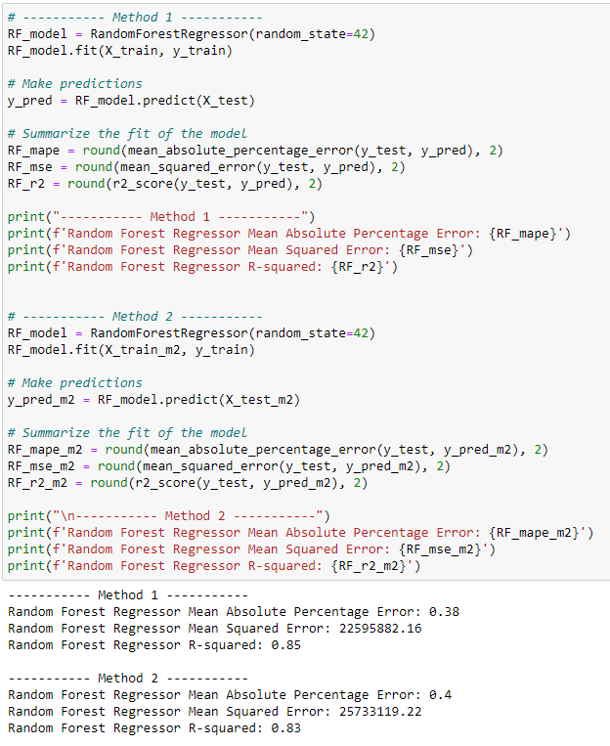
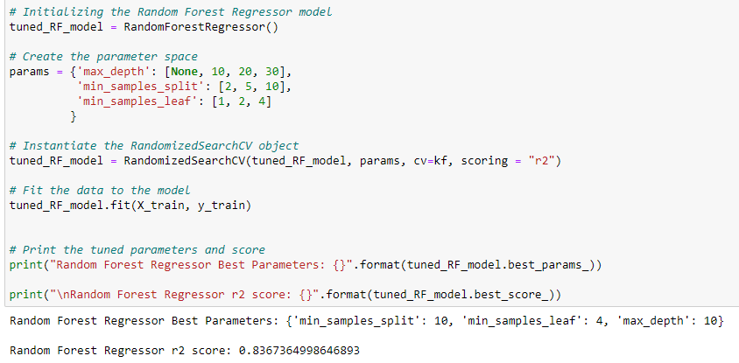
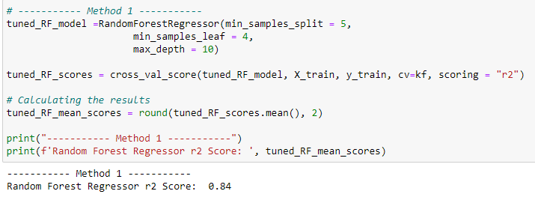
Random Forest Regressor
2.
1.
Applying both methods, by fitting the 2 different X_trains into Random Forest Regressor and output the 3 scores
Tune the hyperparameters of Random Forest Regressor
Using Cross Validation to find the r_squared which will be used for comparison
Method 1 is better
3.

Slide 16
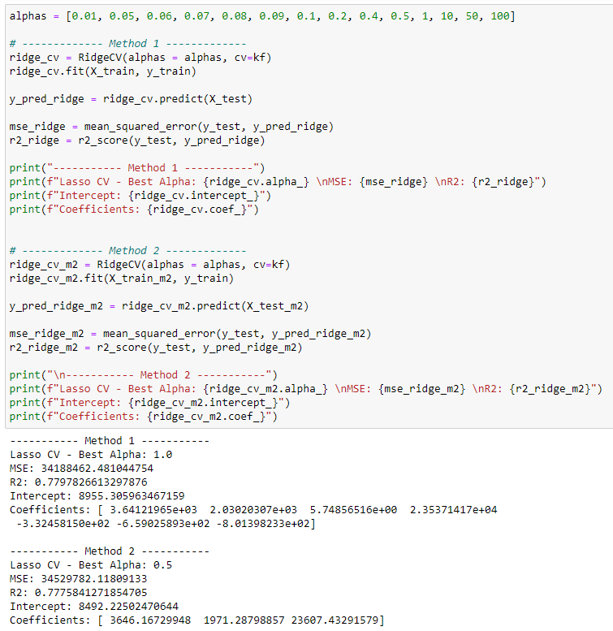
Ridge CV
RidgeCV is cross validation method in ridge regression. Ridge Regression is a special case of regression which is normally used in datasets which have multicollinearity.
- My definition: Ridge takes all the features and balances the impacts of each feature, making all features balance and predicting.
Method 1 is better (Maybe because Method 1 contains more features compared to Method 2)

Slide 17
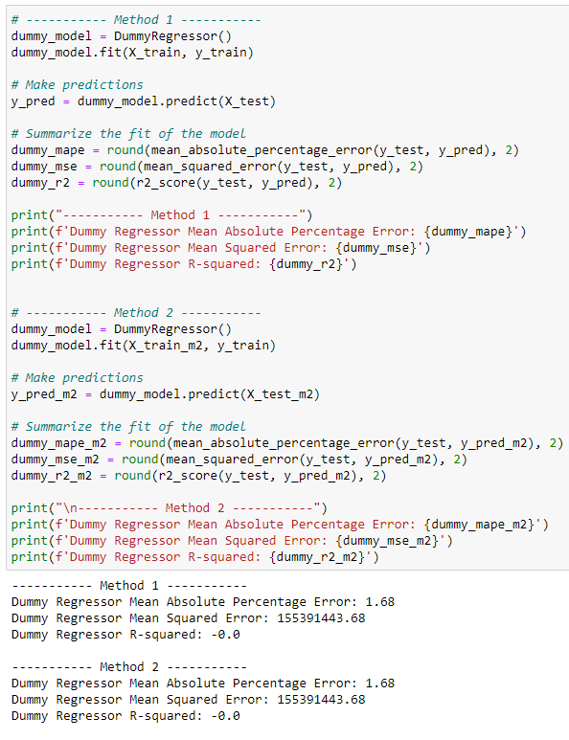
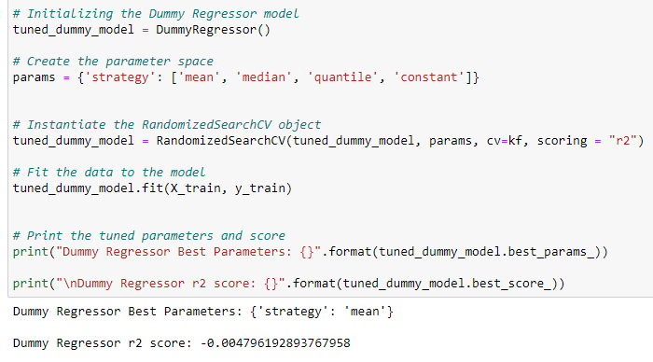
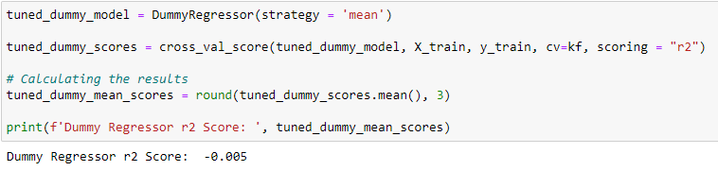
Dummy Regressor
1.
2.
Applying both methods, by fitting the 2 different X_trains into Dummy Regressor and output the 3 scores
Tune the hyperparameters of Dummy Regressor
Using Cross Validation to find the r_squared which will be used for comparison
Method 2 is better
3.

Slide 18
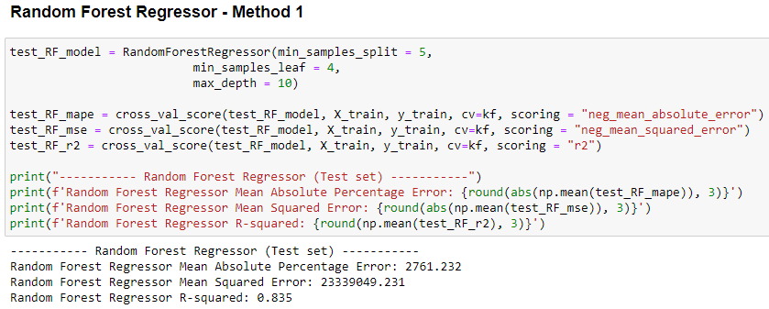
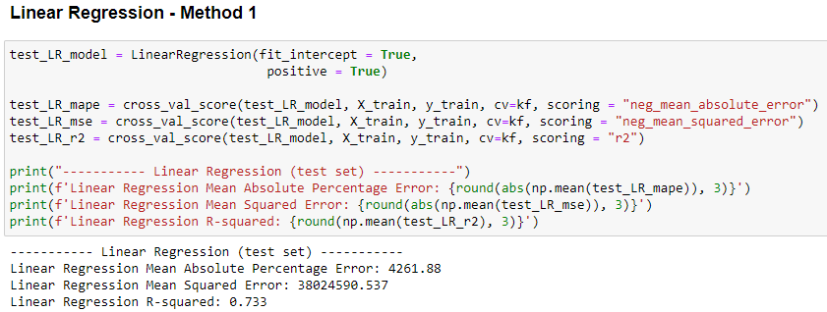
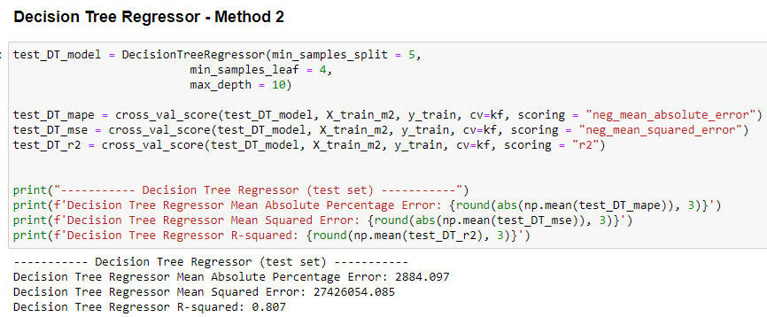
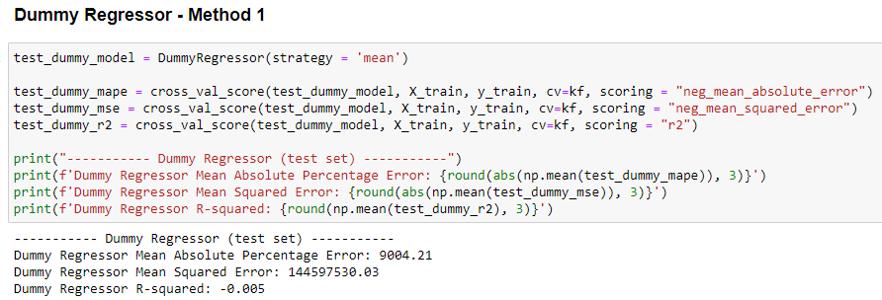
Step 4: Evaluating results output
Using Cross Validation to obtain MSE, R^2, MAPE to compare all models, to find out the best model out of the models
Best Model with the best scores: Random Forest Regressor
This Tuned Random Forest Regressor has higher scores for all 3 scores metrics (MAPE, MSE, R2) compared to the Dummy Regressor.

Slide 19
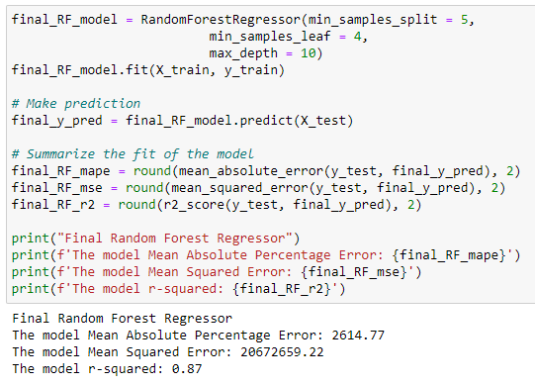
Final Model: Random Forest Regressor
Step 5: Fitting the final model
The final 3 scores:
MAPE = 2614.77
MSE = 20672659.22
R2 = 0.87

Slide 20
How is your prediction task defined?
Ans: Predicting the Cost($) based on the given features
And what is the meaning of the output variable?
Ans: The output is the Cost($) → hospital costs in US hospitals based on patient information
Did you process the features in any way?
Ans: Removing duplicates (if any), Impute any missing values (if any), Check for outliers, Creating dummy variables.
How did you select which learning algorithms to use?
Ans: I chose regression models that I can find on Sklearn, however there are still some regression models I didn’t choose as I may not know how to use them yet.
Did you try to tune the hyperparameters of the learning algorithm, and in that case how?
Ans: I try to search up online on how I can tune the hyperparameters of the different regression models and apply guess and check to see if it increases my models’ performances.
How do you evaluate the quality of your system?
In this regression problem, I’m using 3 score metrics: MSE, MAPE, R2
How well does your system compare to a dummy baseline?
My best model (Tuned Random Forest Regressor) performed better compared to the dummy baseline (having higher scores for all 3 score metrics)
Is it possible to say something about which features the model considers important?
Yes, some features are considered important due to Lasso CV, as it drops redundant features and only choose the features that are important.

